Slide 1
Community Patterns of the Continuous Plankton Recorder Survey
History of the Gulf of Maine CPR & Major drivers in zooplankton community composition.
Adam Kemberling
January 7, 2021

Slide 2
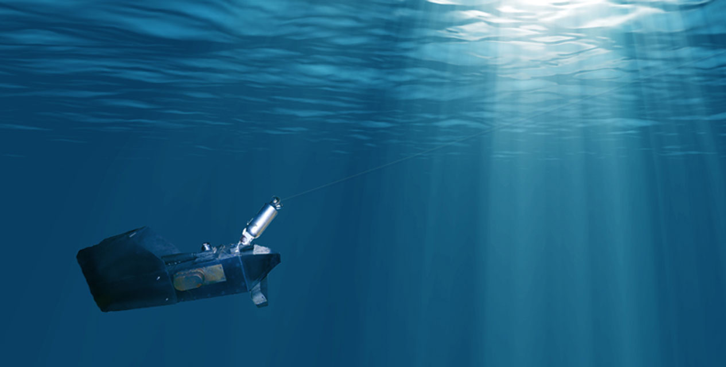
CPR Survey Methods How and why of the CPR Survey
“Horizontally integrated” sampling procedure named for the specialized sampling gear.
Sampler towed behind ships of opportunity along regularly traveled routes, tow depth ~10m.
Water enters through small opening aperture as it is towed.
Internal mechanisms allow for continuous deployment and sample preservation.

Slide 3
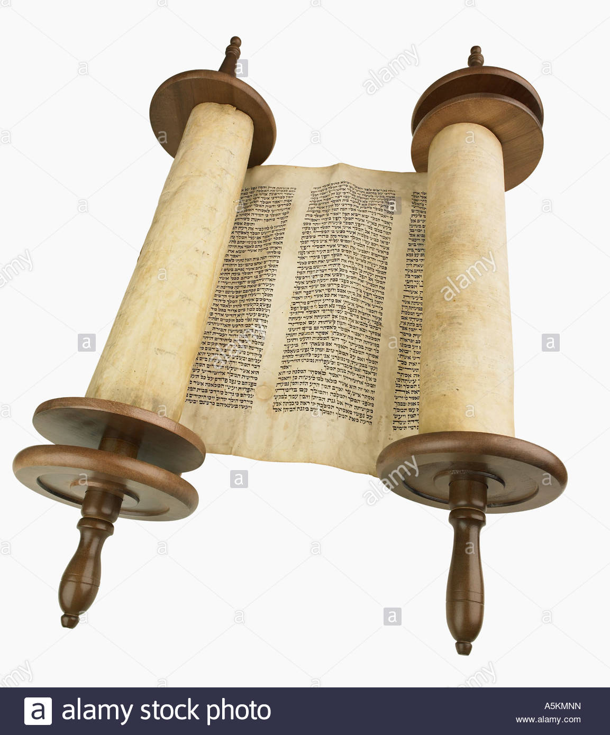
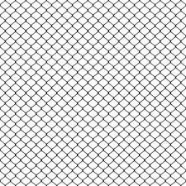

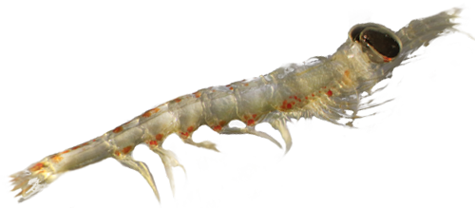
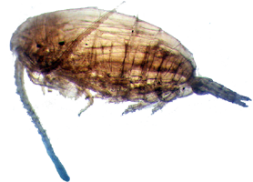
CPR Survey Methods How and why of the CPR Surveys
As sea water flows through the sampler it passes through a silk mesh upon which copepods and other plankton become trapped.
Water exits the device, driving an impeller which winds the silk mesh. Specimens are wound into separate chamber containing preservatives/fixatives.
Sample transects consist of a section of wound silk roughly equaling the 10nm of travel through the water.
Single transect, cut from spool:
10 cm mesh = 10 nautical miles traveled
Mesh size = 270 micrometers
Silk Mesh Spools:
Like this, but with silk mesh.

Slide 4
CPR Survey Methods Phytoplankton Color Index and Category Counting System
Phytoplankton Color Index PCI –
Discoloration of silk mesh ~approximates concentration of phytoplankton
Color of mesh matched to color swatches equating to known densities of phytoplankton
'Green-ness' is a value determined by comparing the silk to a color chart (0, no green; 1, very pale green; 2, pale green; 6.5, green).
'Plankton Field Analysis' is the identification and count of phytoplankton under high power magnification for 0.001 of the silk block.
Zooplankton Categorical Counting System -
Zooplankton concentrations are not counted to the individual
Visual inspection of zooplankton done at different visual scales:
'Zooplankton Transverse Analysis' is the identification and count of zooplankton at low magnification for 0.02 of the silk block.
'Zooplankton Eye Count Analysis' is the identification and count of zooplankton > 2mm for the whole silk block.
From the sub-sections, abundances of observed taxa are assigned a number on an ordinal scale
Ordinal scale corresponds to approximate estimates of zooplankton density

Slide 5
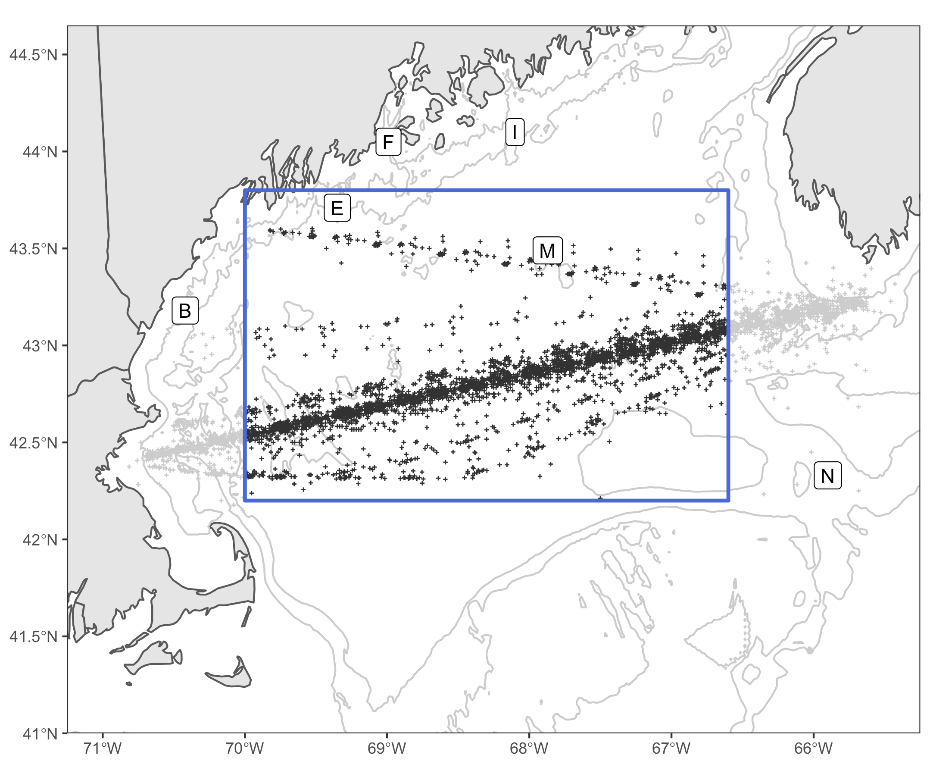
GoM Transect Survey History Changes in ownership/design of the Gulf of Maine CPR
The Gulf of Maine Continuous Plankton Recorder Survey began in 1961 with operations alternating between NOAA and the Sir Alister Hardy Foundation (SAHFOS, now Marine Biology Association of UK)
Data gaps occur in 1974-1977 and 2018-2020.
Gulf of Maine Survey resumed in winter of 2020-21 under funding through NOAA and coordination with MAB and Woods Hole Oceanographic Institute.
1961-1974 SAHFOS
1975-2013 NOAA
2014-2017 SAHFOS
2020-???? NOAA
May 2014
Transect Shifts to Portland

Slide 6


Key Species

Slide 7
Important Zooplankton of the CPR Survey Key species to the nearshore ecosystem
Gulf of Maine Transect:
Mid-Atlantic Bight Transect:
Most Common | Percent Occurrence | Highest Density | Mean Density (#/100 cubic meters)
Calanus finmarchicus V-VI | 85% | Calanus finmarchicus I-IV | 12,173
Euphausiacea spp. | 55% | Centropages typicus | 10,761
Para/Pseudo-calanus spp. | 52% | Radiolaria spp. | 9,247
Calanus finmarchicus I-IV | 51% | Acantharia spp. | 9,045
Centropages typicus | 49% | Para/Pseudo-calanus spp. | 4,908
Most Common | Percent Occurrence | Highest Density | Mean Density (#/100 cubic meters)
Chaetognatha - Adult | 49% | Sarcodina (not foraminiferida) | 2,960
Decapoda-arthropoda (not brachyura) | 12% | Centropages typicus | 1,476
Pleuromamma borealis | 12% | Para/Pseudo-calanus spp. | 1,052
Thecosomata | 8.9% | Penilia avirostris | 1,022
Euphausiacea | 8.5% | Thecosomata | 947

Slide 8
Calanus finmarchicus Key zooplankton species
Diapause life history strategy:
Adult Calanus finmarchicus overwinter at depth through a process known as diapause
During this period C. finmarchicus does not feed/grow/molt, relying on stored lipid energy reserves
These lipid stores allow C. finmarchicus to leave the surface waters to escape predation and other unfavorable conditions
Ecological significance
Calanus’ high lipid content makes them an energy dense food source for critically endangered species like the North Atlantic right whale.
Calanus’ ability to store carbon as lipids maintains carbon/energy in the food web with Calanus, rather than passing it through via respiration/predation/excretion
Accumulation of carbon in c. fin via lipid storage has been referred to as a “lipid battery”
The amount/size of the “lipid battery” having implications for the foraging success of seasonal foragers like right whales etc.

Slide 9

Temperature and the Gulf of Maine Copepod Community

Slide 10
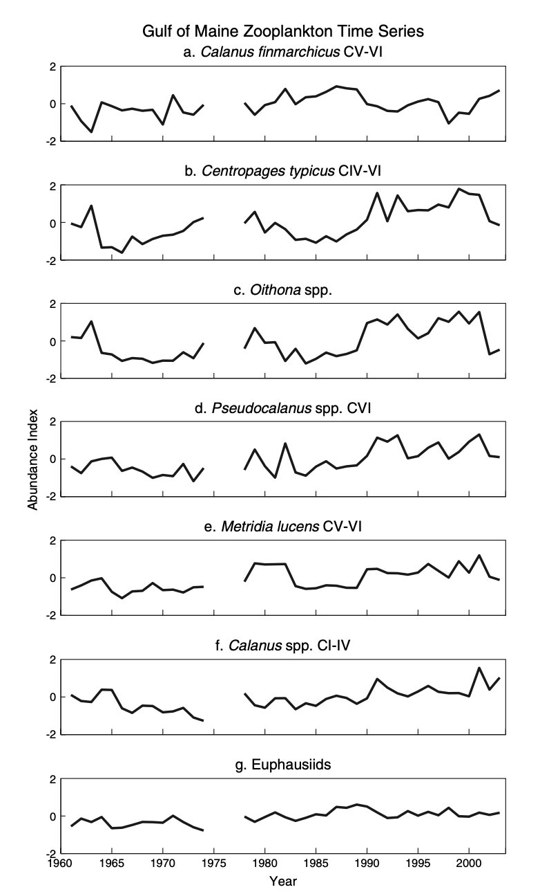
Community Dynamics of the GOM Pershing et al. 2005, Interdecadal variability in the Gulf of Maine Zooplankton Community…
Goal: Document changes in zooplankton community over the last 4 decades (1961-2003)
Relate community changes to recruitment in Gulf of Maine fish stocks.
Approach:
For 6 important taxa, create time-series of relative abundances using periodic splines fit to log-transformed abundance
Examine relationships between these focal taxa using Principal Component Analysis (PCA)
Compare zooplankton community principal components so recruitment timeseries of 12 fish stocks in Gulf of Maine.

Slide 11
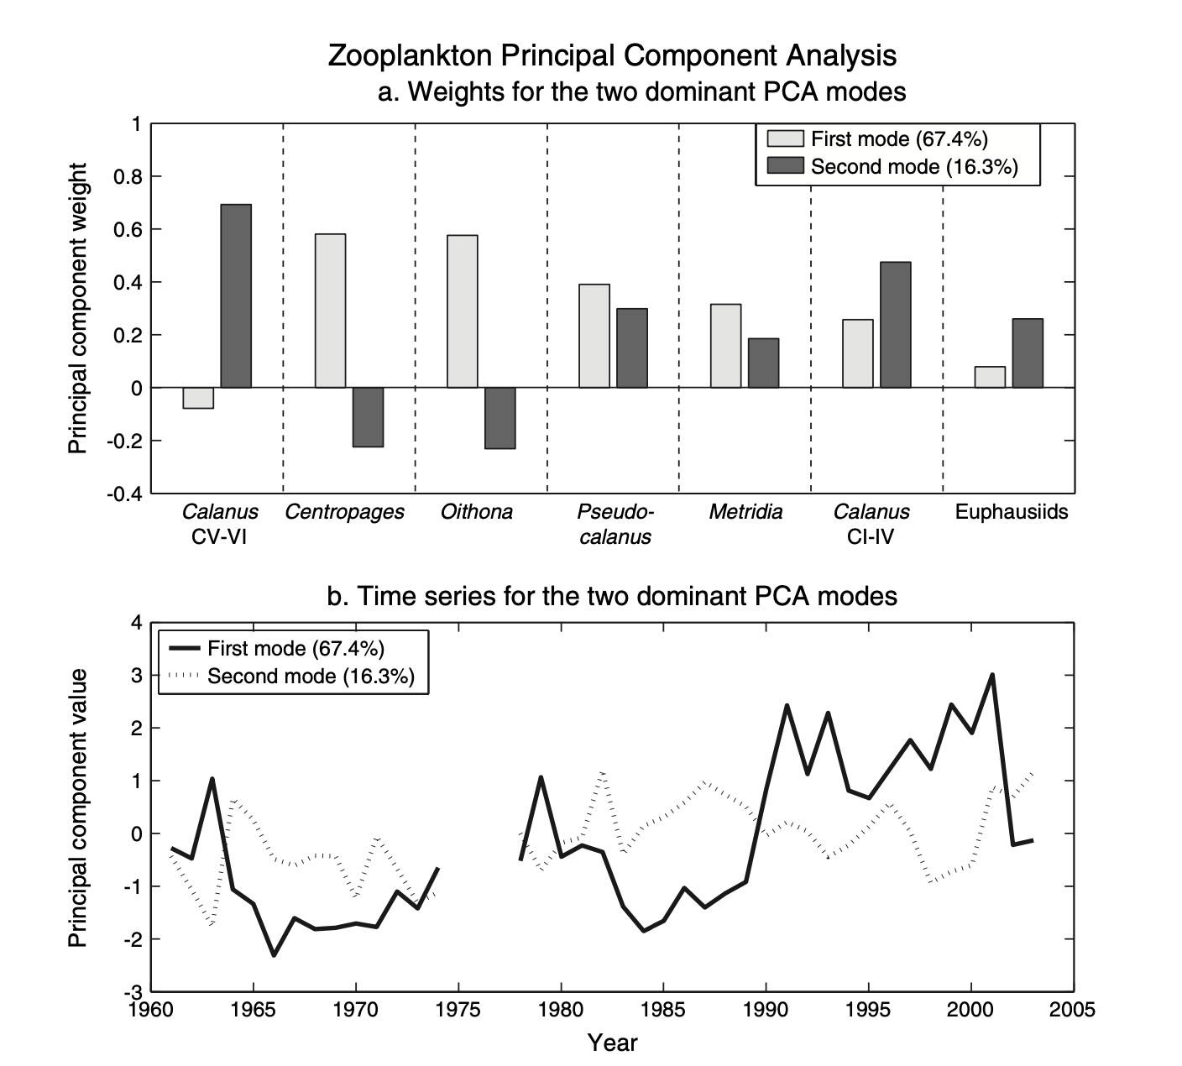
Community Dynamics of the GOM Pershing et al. 2005, Zooplankton Community PCA Results
“Our analysis indicates that there are two dominant patterns in the year-to-year changes in the Gulf of Maine zooplankton community, represented by the leading principal component modes…
…The leading mode from the PCA indicates that the Gulf of Maine witnessed a major ecological change between 1989 and 1990. This mode represents a fundamentally new pattern, one that has the potential to impact higher trophic levels, and it likely reflects other physical and biological changes in the region. The broad result of this change was an apparent increase in community diversity resulting from a shift away from C. finmarchicus towards smaller taxa.”
~Pershing et al. 2005

Slide 12
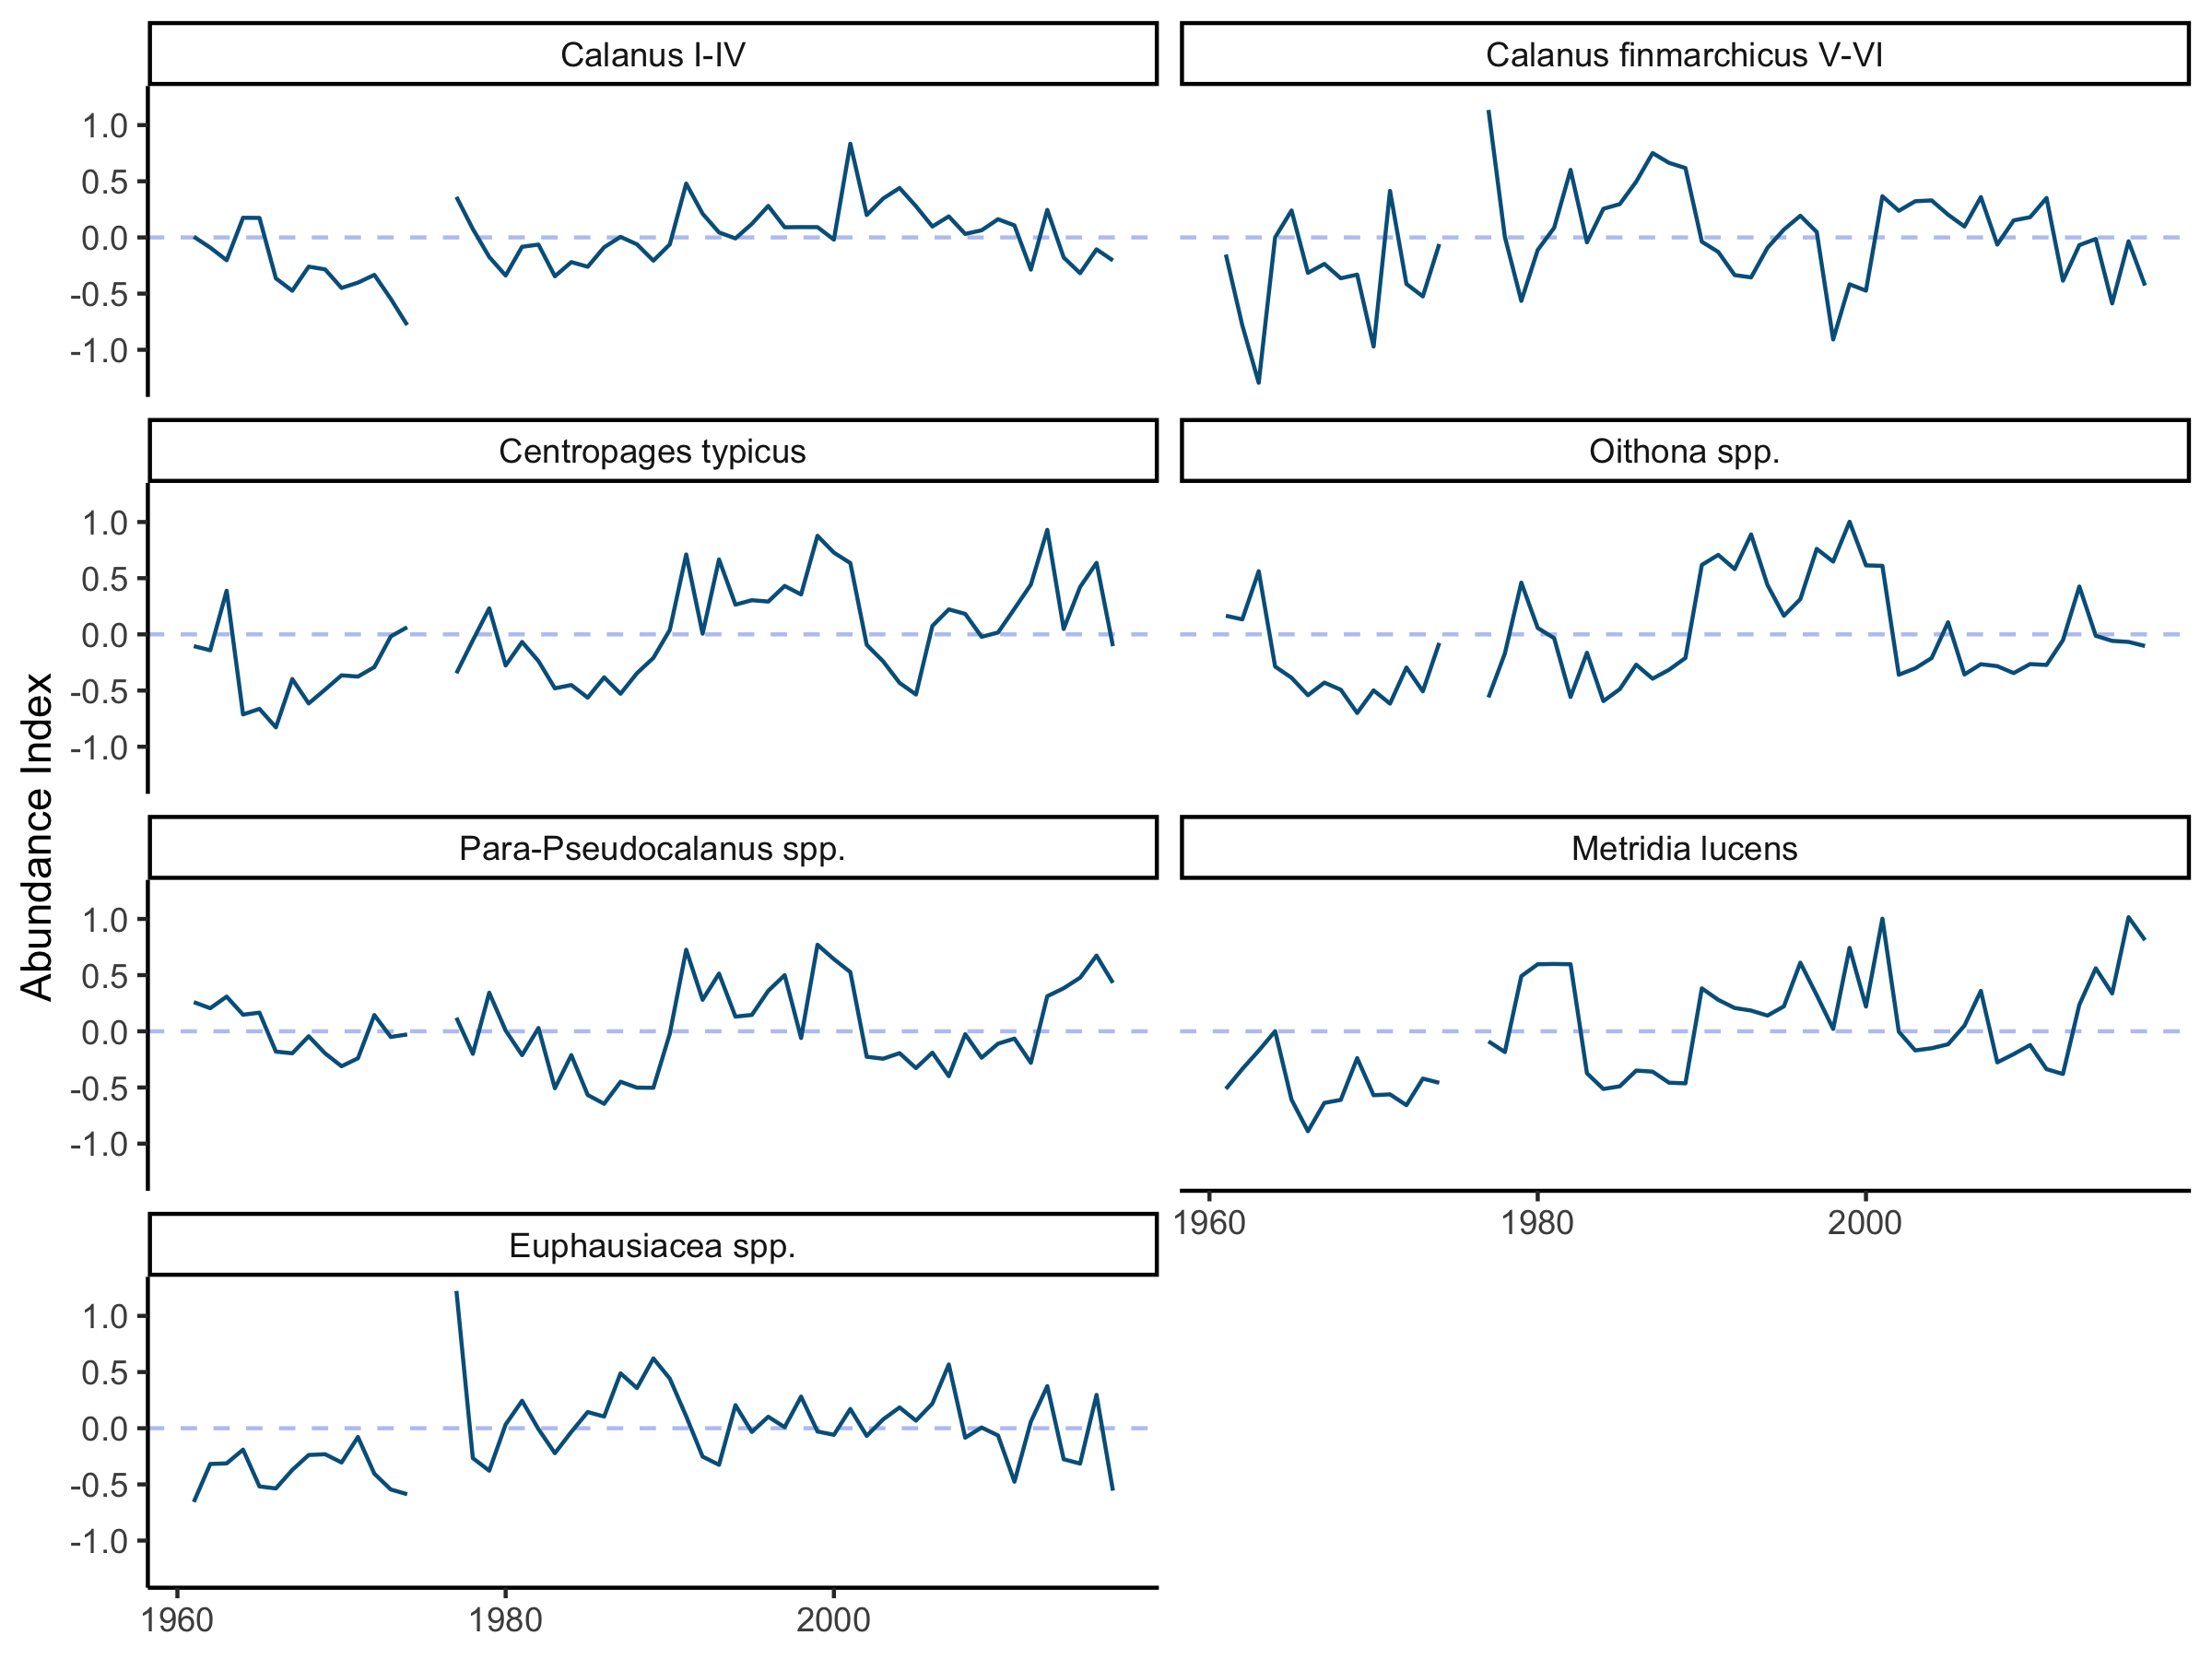
Community Dynamics of the GOM Gulf of Maine 2050 Analysis
Hypothesis: The decline of Calanus and the increase in smaller copepods that we observed in the 1990s represents a consistent community-level response to external forcing.
Compare decadal changes in the zooplankton community from 1980-2017 and contrast these changes with changes in hydrography.
Approach:
Re-create time-series of relative abundances using GAMs fit to log-transformed abundance
Examine relationships between these focal taxa using Principal Component Analysis (PCA) for 3 time periods (1961-2003, 2001-2017, & 1961-2017)
Compare zooplankton community principal components to changes in sea surface temperature and NERACOOS buoy data

Slide 13
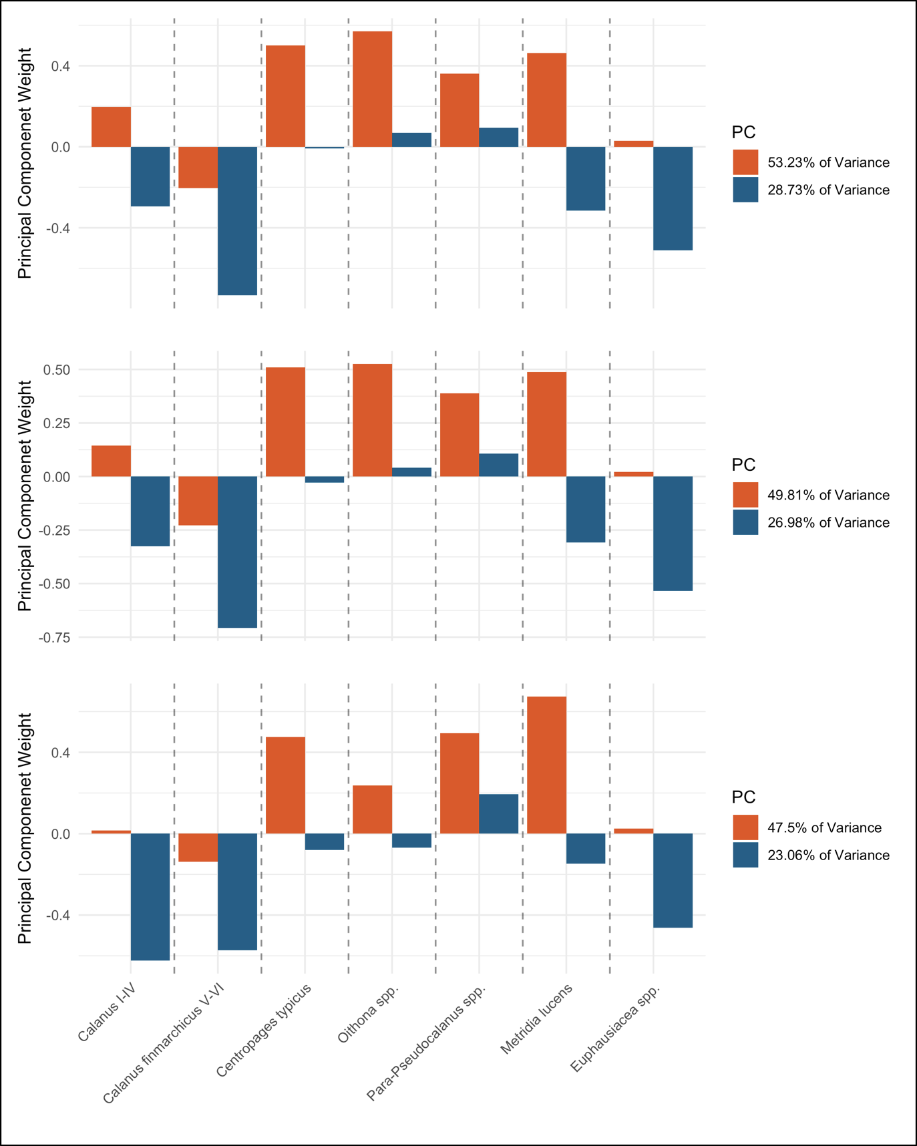
Community Dynamics of the GOM Zooplankton Community PCA’s (3)
A.
Principal component loadings for the six taxa of interest over three time periods as generated by independent PCA’s for the period were used to identify groups of zooplankton that respond similarly to known/unknown external forcing. Panel (A.) represents the period covered by previous work. Performed to validate anomalies, and to extend through recent years. Panel (B.) was generated using all years where buoy data was available (2001-2017). Used to contrast against earlier communities, and to compare with buoy data. Panel (C.) spans the entirety of the Gulf of Maine CPR data, (1961-2017). This represents the long-term community structure, very similar to original study, supporting conclusions.
B.
C.

Slide 14
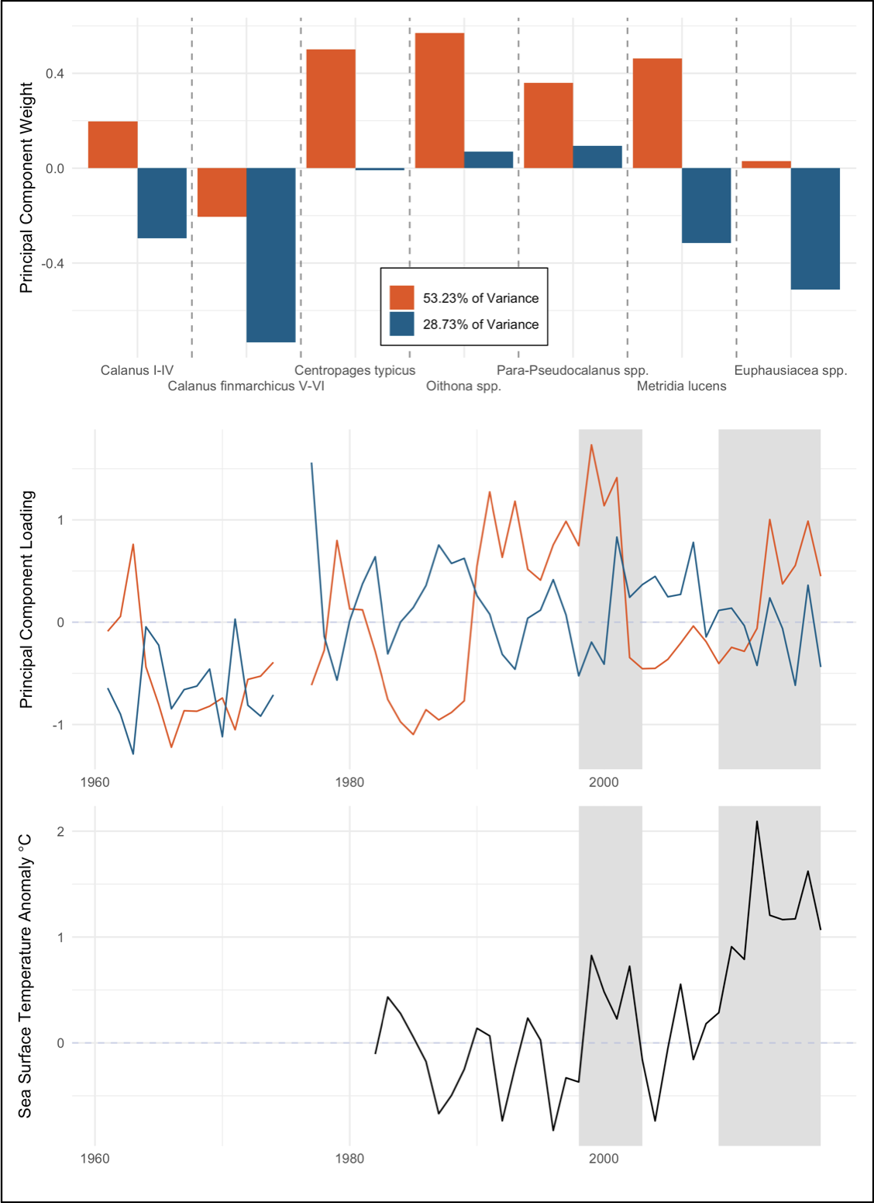
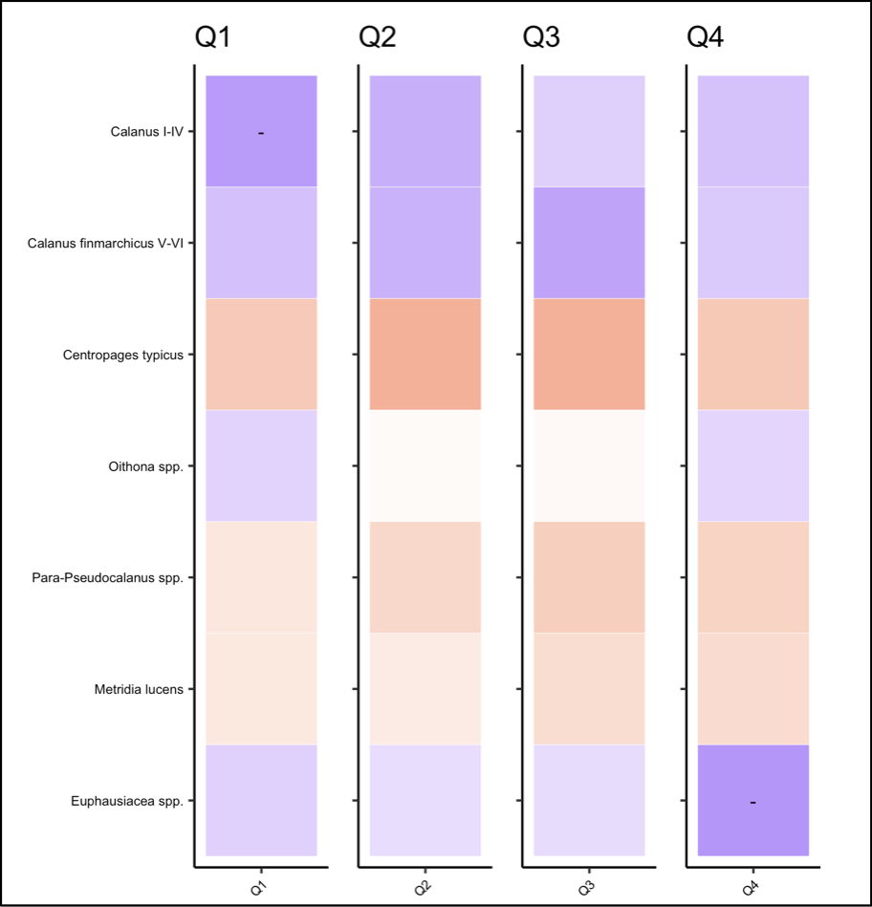
Community Dynamics of the GOM Hydrographic Forcing – Sea Surface Temperature
Relationship between zooplankton community PCA and Sea Surface Temperature:
Patterns in the PCA timelines from the 1961-2001 period were visually compared to sea surface temperature trends (right).
Relationship of SST to specific taxa (below).

Slide 15
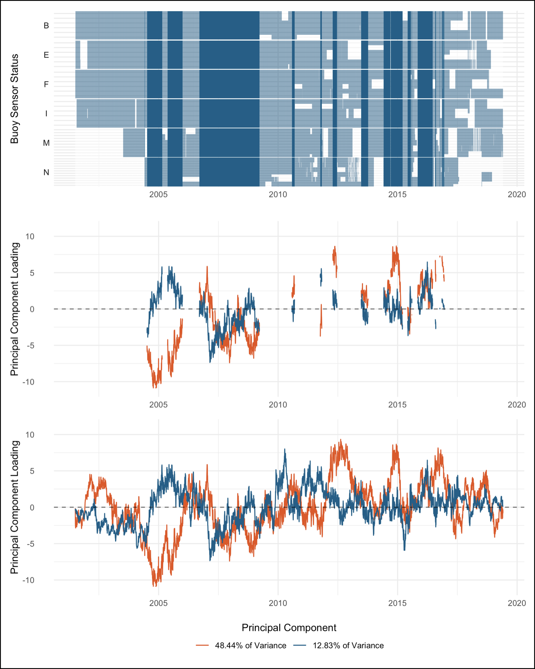
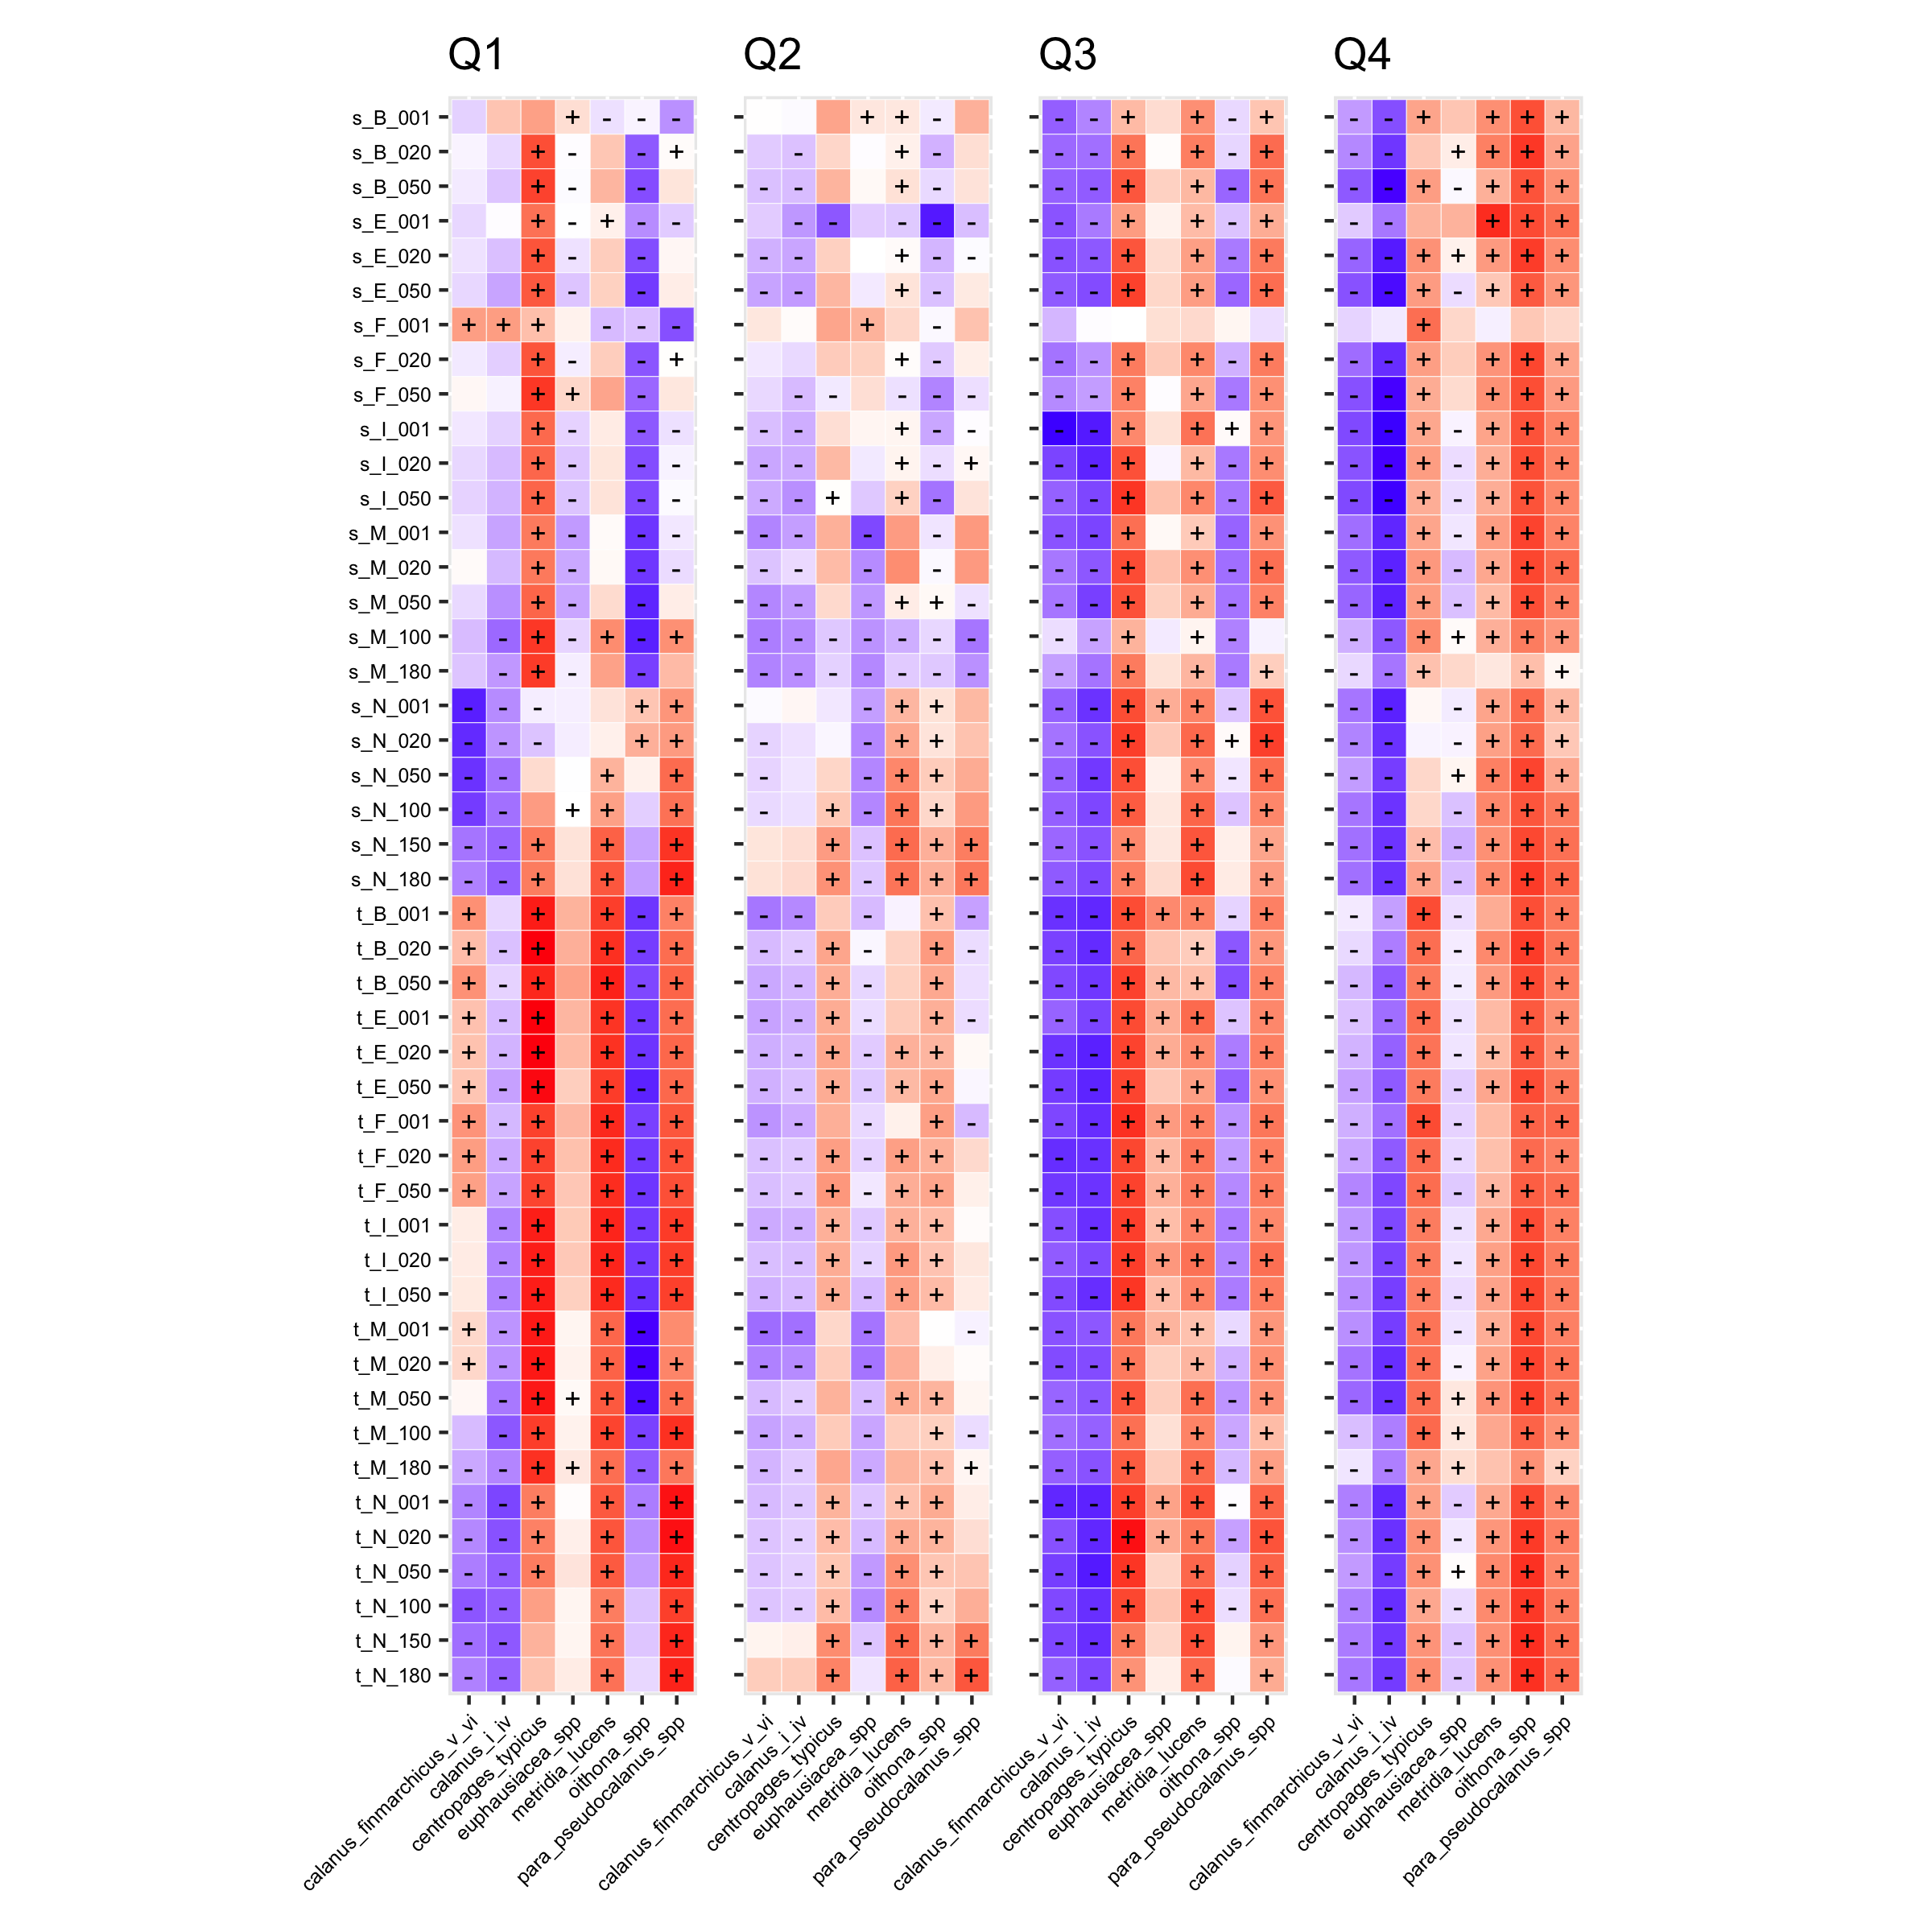
Community Dynamics of the GOM Hydrographic Forcing – NERACOOS Buoy Data
A Principal Component Analysis was used to reduce the dimensions of the NERACOOS array data (mean daily temperature and salinity) to two principal components.
Correlations between the NERACOOS array principal components and zooplankton concentration anomalies were then inspected.
The reason to perform a PCA:

Slide 16
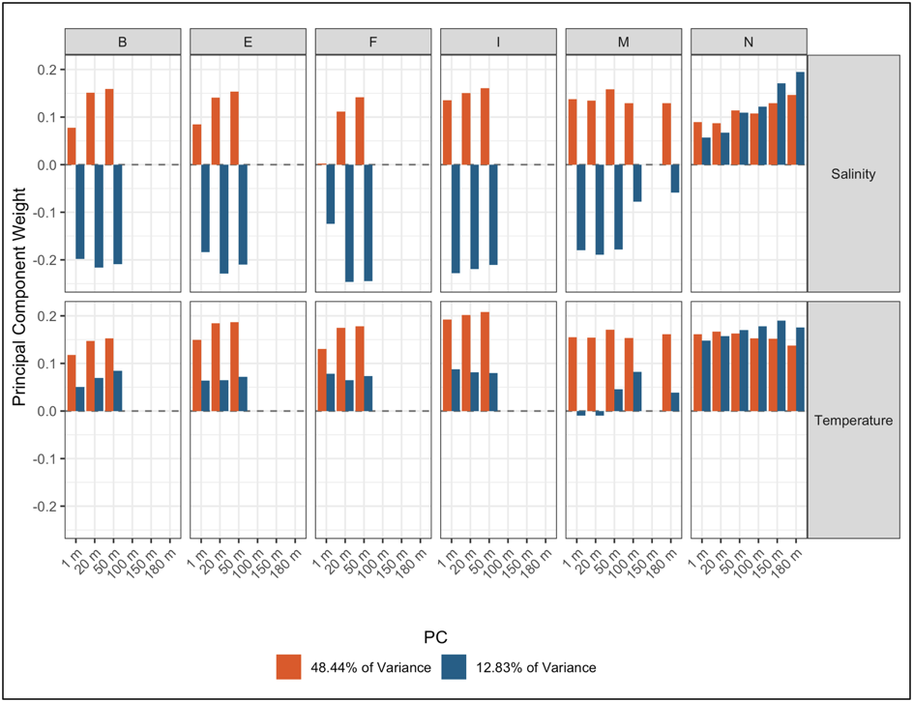
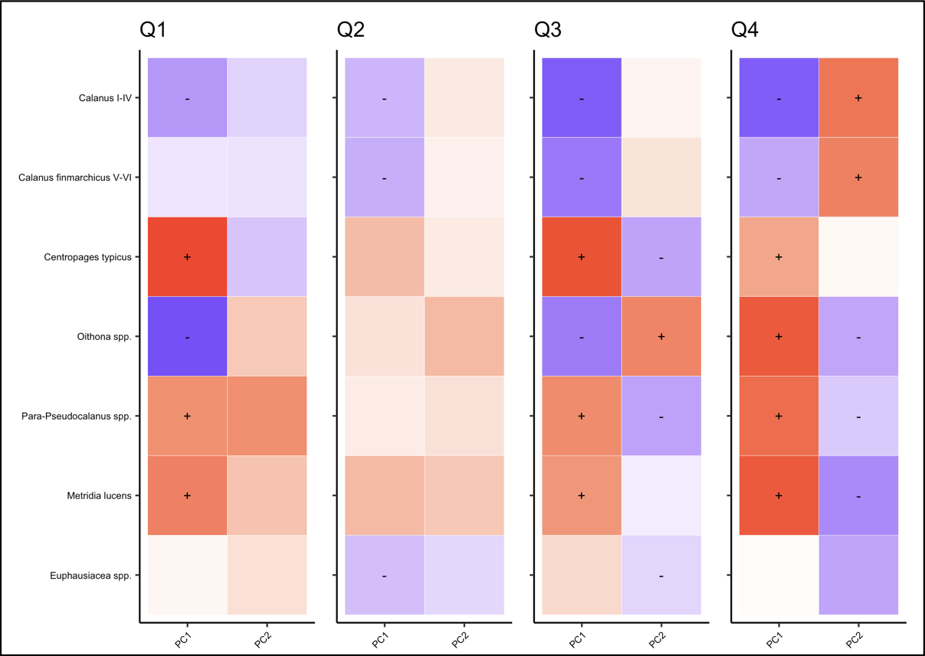
Community Dynamics of the GOM Hydrographic Forcing – NERACOOS Buoy Weights
Principal Component 1:
Looking at the individual relationships between abundances of these focal taxa and sea surface temperature does not provide strong evidence for a strictly-temperature driven relationship, however the direction of those relationships among the different groups of taxa is consistent with the leading mode of the NERACOOS buoy array (PC1) which we interpret foremost as a signal of temperature and salinity coupling, a relationship commonly observed in oceanic systems.

Slide 17
Community Dynamics of the GOM Hydrographic Forcing – NERACOOS Buoy Weights
Principal Component 2:
There is a clear asynchrony between loadings for the inshore buoys of the array and buoy N in the Northeast Channel for the second principal component (PC2). We posit that these patterns in PC2 relate to offshore current dynamics that bring warmer, saltier water at depth into the Gulf of Maine.

Slide 18
Community Dynamics of the GOM Discussions… ongoing
In recent years the Gulf of Maine has experienced some of the fastest oceanic warming rates of any region on the planet.
Temperature on its own, while important, does not tell the whole story.
Using the inshore/offshore influence as a lens (Buoy PC2) supports the hypothesis that regime shifts from a Calanus dominated Gulf of Maine zooplankton community to a smaller-bodied copepod community is driven by the physics of the region and their impacts on stratification and mixing patterns across the GOM.
Understanding additional processes like seasonal stratification patterns, advection and transport etc. seems as/more important for a species like C. finmarchicus with a longer life span with time spent in/out of surface waters.
Continuous plankton recorder data is not the whole picture. Physical forcings are evident, though complicated.

Slide 19
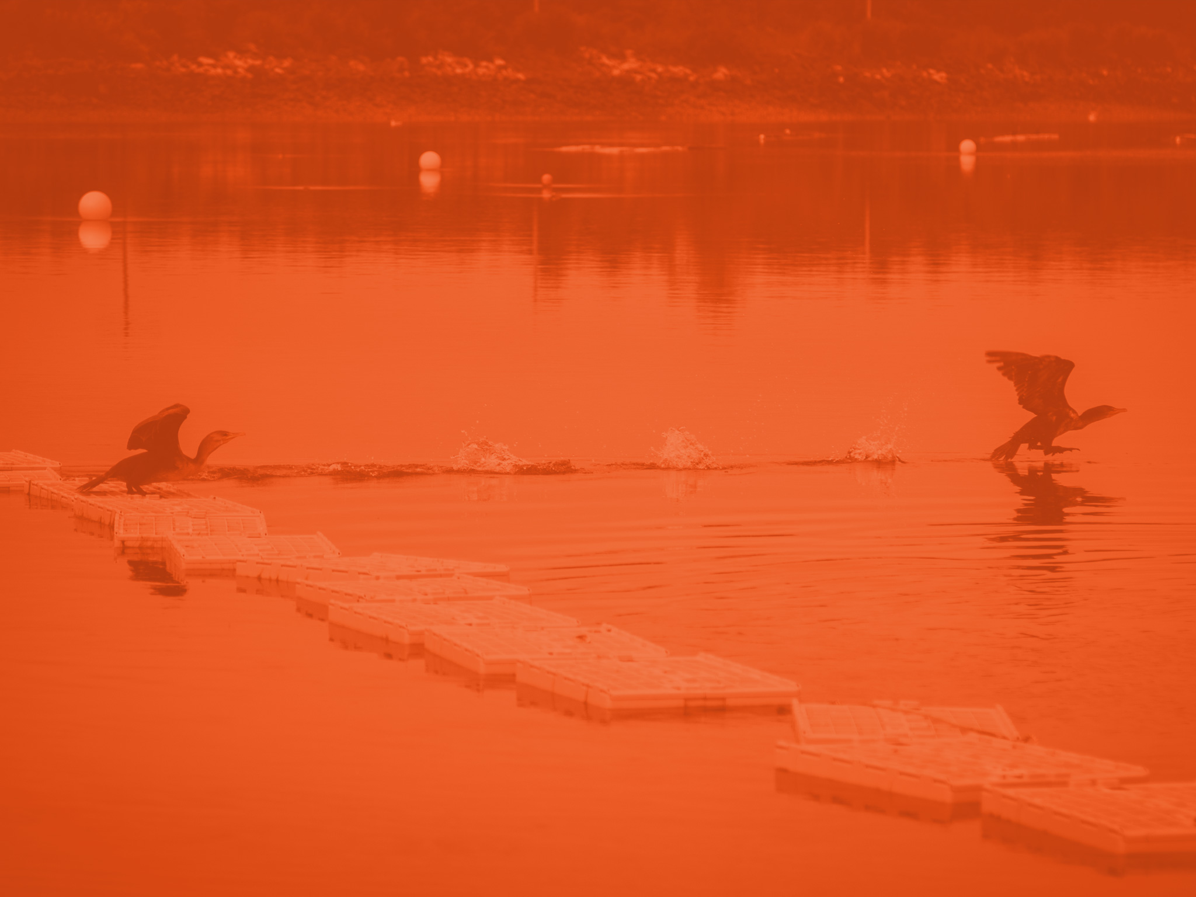
CPR Resources and New Questions

Slide 20
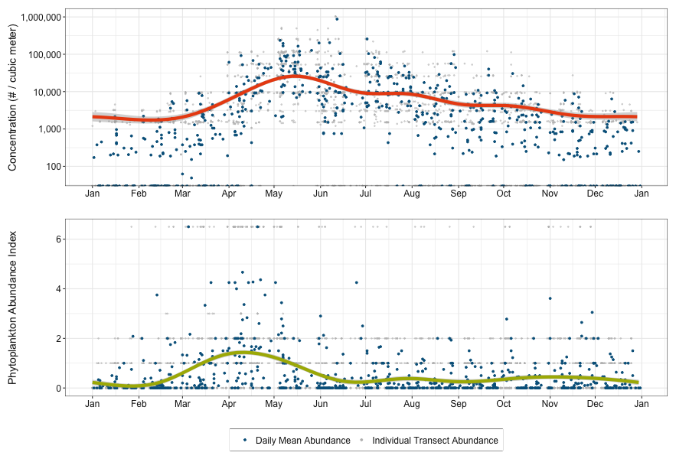
Uses for CPR Data at GMRI CPR derived products for other projects: (permissions pending)
Zooplankton and Phytoplankton Color Seasonal Variability
CPR Community PCA Timeseries
NERACOOS Buoy Gap Interpolations and PCA Timeseries

